Slide 1
MOBILE PROGRAMMING / WEEK 06 PROJECT
LIFTIQ
Plan your workouts.
Track your progress.
A gym app for creating workout plans, recording exercises, and keeping track of each session.
MEMBERS: Omar Mohamed Samir(26100994)
Mohamed Abdulhaleem(26100413)
Ziad Mohamed(26103454)
Yassin Ehab(26103578)
Kevin Wael(26104126)
LIFTIQ / FOUNDATION YEAR • MOBILE PROGRAMMING
01

Slide 2
01 / TEAM & CUSTOMER
Customer discovery
We explored the challenges people face when organising their gym workouts.
TARGET CUSTOMER
THE PROBLEM
WHAT WOULD HAVE HELPED
Customer background.
Problem statement
What users need in one app
The customer complained that he:
•Took a lot of time Searching online for workout routines
• Write the exercises in his phone Notes
• Use the phone stopwatch to time rest breaks
The customer found it inconvenient to switch between different apps and tools to manage their workouts.
• Keep workout exercises together in one place
• Follow the workout without searching again
• Record sets, reps, and weights
• Time rest breaks inside the same app
Track progress
LiftIQ provides a solution by bringing workout organisation, set tracking, and rest timing together in one app.
LIFTIQ / FOUNDATION YEAR • MOBILE PROGRAMMING
02

Slide 3
02 / APP IDEAS & SELECTION
Three ideas considered
We compared three ideas and considered which one we could build well during the semester.
IDEA 01
IDEA 02
IDEA 03
LiftIQ
Study Planner
Expense Tracker
Create workout plans and record sets, reps, weights, and rest time.
Why it stood out: We saw an opportunity to create a practical gym app with useful features that we could realistically develop during the semester.
Organize assignments, deadlines, and study sessions.
Why we did not choose it: We wanted to focus on an app idea that was more practical for our team's interests and development goals.
Record purchases, organise spending, and set budgets.
Why we did not choose it: useful expense tracking needs categories, budgets, and careful handling of personal money data.
OUR CHOICE: LiftIQ — we understand the problem, and its main features are achievable for this semester.
LIFTIQ / FOUNDATION YEAR • MOBILE PROGRAMMING
03

Slide 4
03 / APP PROPOSAL
LiftIQ: what the app will do
For people who are new to the gym or want an easier way to organise their strength workouts.
STATEMENT
PROPOSAL
VALUE
Problem
Solution
Value
People often search online for workout routines, save exercises in their Notes, and use a separate timer for rest periods.
LiftIQ brings workout plans, exercise tracking, and a rest timer together in one app.
Users can follow their routine and record their workout without switching between Notes and the stopwatch.
CORE
OPTIONAL
MAIN FEATURES • FIRST VERSION
EXTRA FEATURES • LATER
• Create and name workout plans
• Add exercises to each plan
• Record sets, reps, and weights
• Mark each set as complete
• Use a rest timer
• Progress tracking
• Videos showing how to do exercises
• A record of past workouts
• Charts showing progress over time
Advanced progress charts and statistics.
HOW IT WORKS: Choose a workout → start → record sets, reps, and weights → take timed breaks → finish the workout.
LIFTIQ / FOUNDATION YEAR • MOBILE PROGRAMMING
04

Slide 5

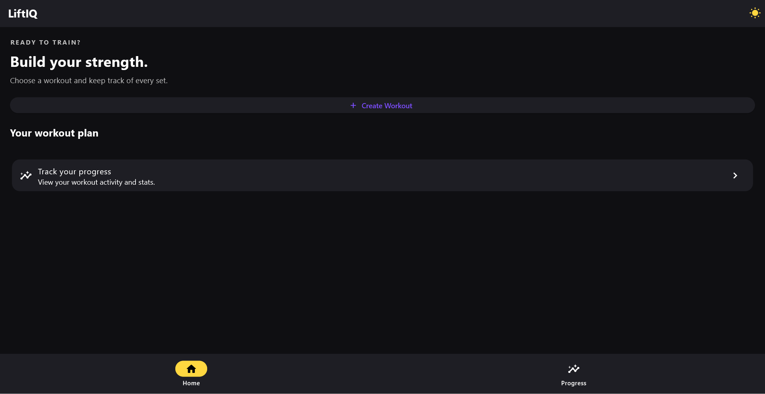
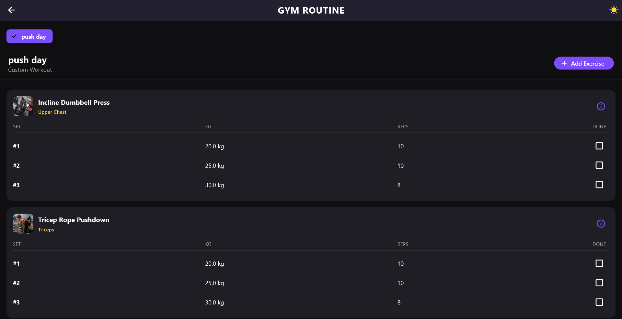
04 / SCREEN DESIGN & NAVIGATION
LiftIQ App Screens
A look at the main screens and features of LiftIQ.
Welcome → Home → Main Workout
01 Welcome screen
02 Home screen
03 Main screen
From Home, start a workout or open the builder to make your own plan.
LIFTIQ / FOUNDATION YEAR • MOBILE PROGRAMMING
05

Slide 6
05 / NEXT STEPS
What we will do next
The next steps are to finish the main features and make sure the app works well.
Identify the needs of people who want to manage their workouts more easily.
Develop the first version around these needs , then gather feedback from users
Finish the screen designs
Make sure that the screens are clear and easy to move between.
Build the main features
Finish workout creation, set tracking, and the rest timer.
Try it and fix problems
Test the app, find problems, and improve it.
Save workout information
Keep workout plans and completed sessions so users can view them later.
GOAL: bring workout plans, set tracking, and rest timing together in one simple app.
LIFTIQ / FOUNDATION YEAR • MOBILE PROGRAMMING
06

